Slide 1
PLEASE DELETE THIS NOTE BEFORE PRESENTING THIS SLIDE.
Please note that this is not a separate presentation or set, just a continuation of slides from one complete powerpoint, split into 3 sections to allow for a manageable filesize for upload/download from toolkit.
This is section 3/3, covering legal wildlife trade, wildlife trafficking in aviation and its impacts on the industry.
Legal
Wildlife
Trade is regulated

Slide 2

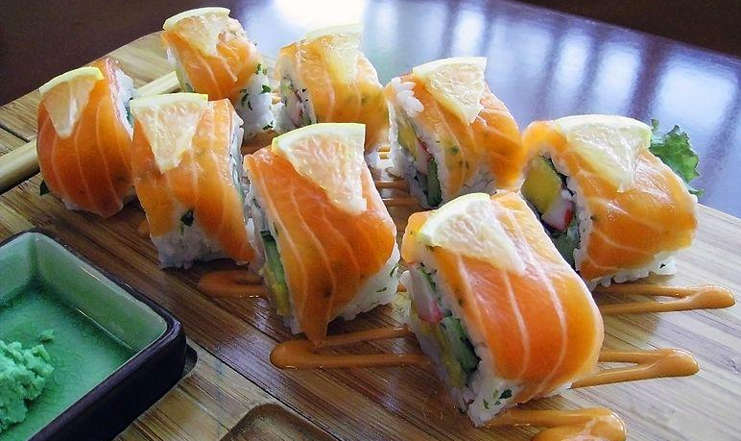
Legal wildlife trade
Worth more than USD 320 billion per year
Photograph by Ckiul, distributed under a CC-BY-SA 4.0 license
Photograph by Gunawan Kartapranata, distributed under a CC-BY-SA 3.0 license
Notes:
The trade in wildlife can be traditional, often has a long history and involves most cultures
It includes much of the fish that we eat and the timber we use for our furniture
Legal wildlife trade is worth around USD 320 billion per year
Chair image: https://commons.wikimedia.org/wiki/File:Wooden_Chair_5678.jpg
Sushi image: https://commons.wikimedia.org/w/index.php?curid=215320

Slide 3
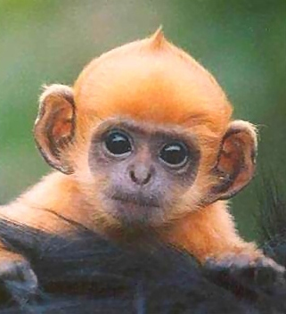
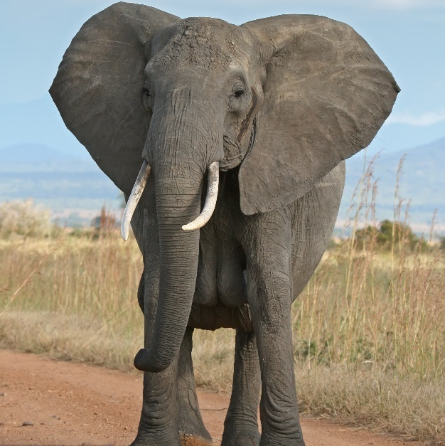
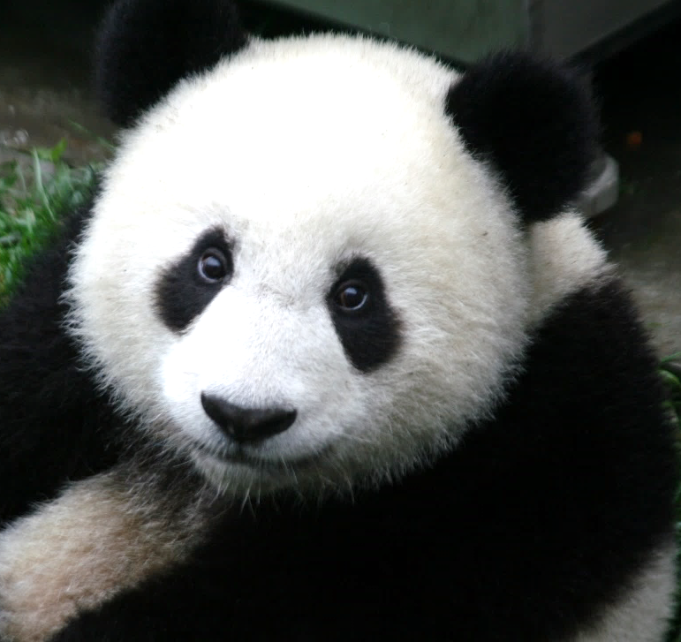
National laws
Every country has laws designed to protect some wild animals and plants from overharvesting.
© Photograph by Rob from Cambridge, MA, distributed under a CC-BY-2.0 license
© Photograph by Muhammad Mahdi Karim, distributed under a GNU Free Documentation License, Version 1.2
© Wikipedia/SheilaLau
Notes:
These usually include rules governing capture from the wild, sale, possession and transport of certain species.
Images:
Langur: Photograph by Rob from Cambridge, MA, distributed under a CC-BY-2.0 license
African Elephant: Photograph by Muhammad Mahdi Karim, distributed under a GNU Free Documentation License, Version 1.2
Giant Panda: http://aplus.com/a/giant-pandas-no-longer-an-endangered-species?no_monetization=true

Slide 4

International regulation
CITES
The Convention on International Trade in Endangered Species of Wild Fauna and Flora
Aims to ensure that international trade does not threaten the survival of wild animals and plants.
The convention has been signed by more than 180 countries.
Notes:
There are also international efforts to address this.
CITES is an agreement between governments which began in 1975.
You can find out all the countries that are party to CITES via this link: https://www.cites.org/eng/disc/parties/chronolo.php?order=field_country_official_name&sort=asc
Being part of CITES means that your government has made a commitment to enforce the Convention.
Each country uses its national laws and enforcement agencies to implement CITES.

Slide 5
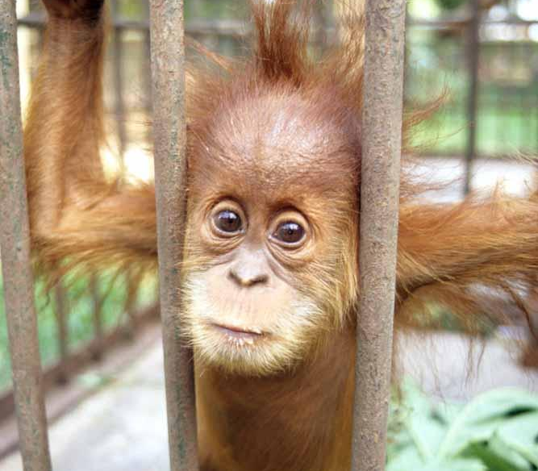
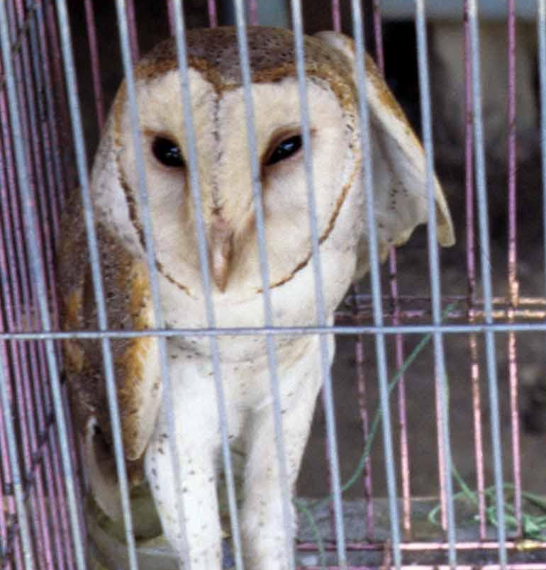
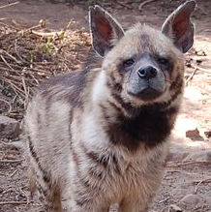
CITES - 35,000 species of plants and animals
Appendix I
Appendix II
Appendix III
© TRAFFIC
© TRAFFIC
© Photograph by Nirmal Dulal, under the CC-SA 3.0 Unported License
At risk of extinction from international trade
May become threatened with extinction if trade is not controlled
Protected in one country which asked others to help control the trade
Refer to your national CITES Management Authority if you need more information
Notes:
A permit is needed for the import, export or re-export of these.
CITES works through a system of permits. A permit is required to take any live, dead, piece or derivative of a CITES-listed animal or plant across an international border. For some species, NO trade is allowed.
Appendix I: Includes species which are at risk of extinction from international trade. Eg. Sumatran Orangutan (Pongo abelii). Only in exceptional circumstances is any trade allowed of Appendix 1 species.
Appendix II: Includes species that may become threatened with extinction if trade is not controlled. Includes “lookalikes” that resemble species in Appendix I and II. Eg. Barn Owl (Tyto alba). Appendix II species may be granted export or re-export permits, but trade is closely monitored.
Appendix III: Includes species protected in at least one country which has asked other CITES member states for help in controlling the trade. Eg. Striped Hyaena (Hyaena hyaena. It is found in over 40 countries, but was listed at the request of Pakistan. (Image: https://commons.wikimedia.org/wiki/File:%E0%A4%B9%E0%A5%81%E0%A4%81%E0%A4%A1%E0%A4%BE%E0%A4%B0.JPG)
For contact details of your national CITES Management Authority check https://www.cites.org/eng/cms/index.php/component/cp

Slide 6
Wildlife
Trafficking In the Aviation Industry

Slide 7
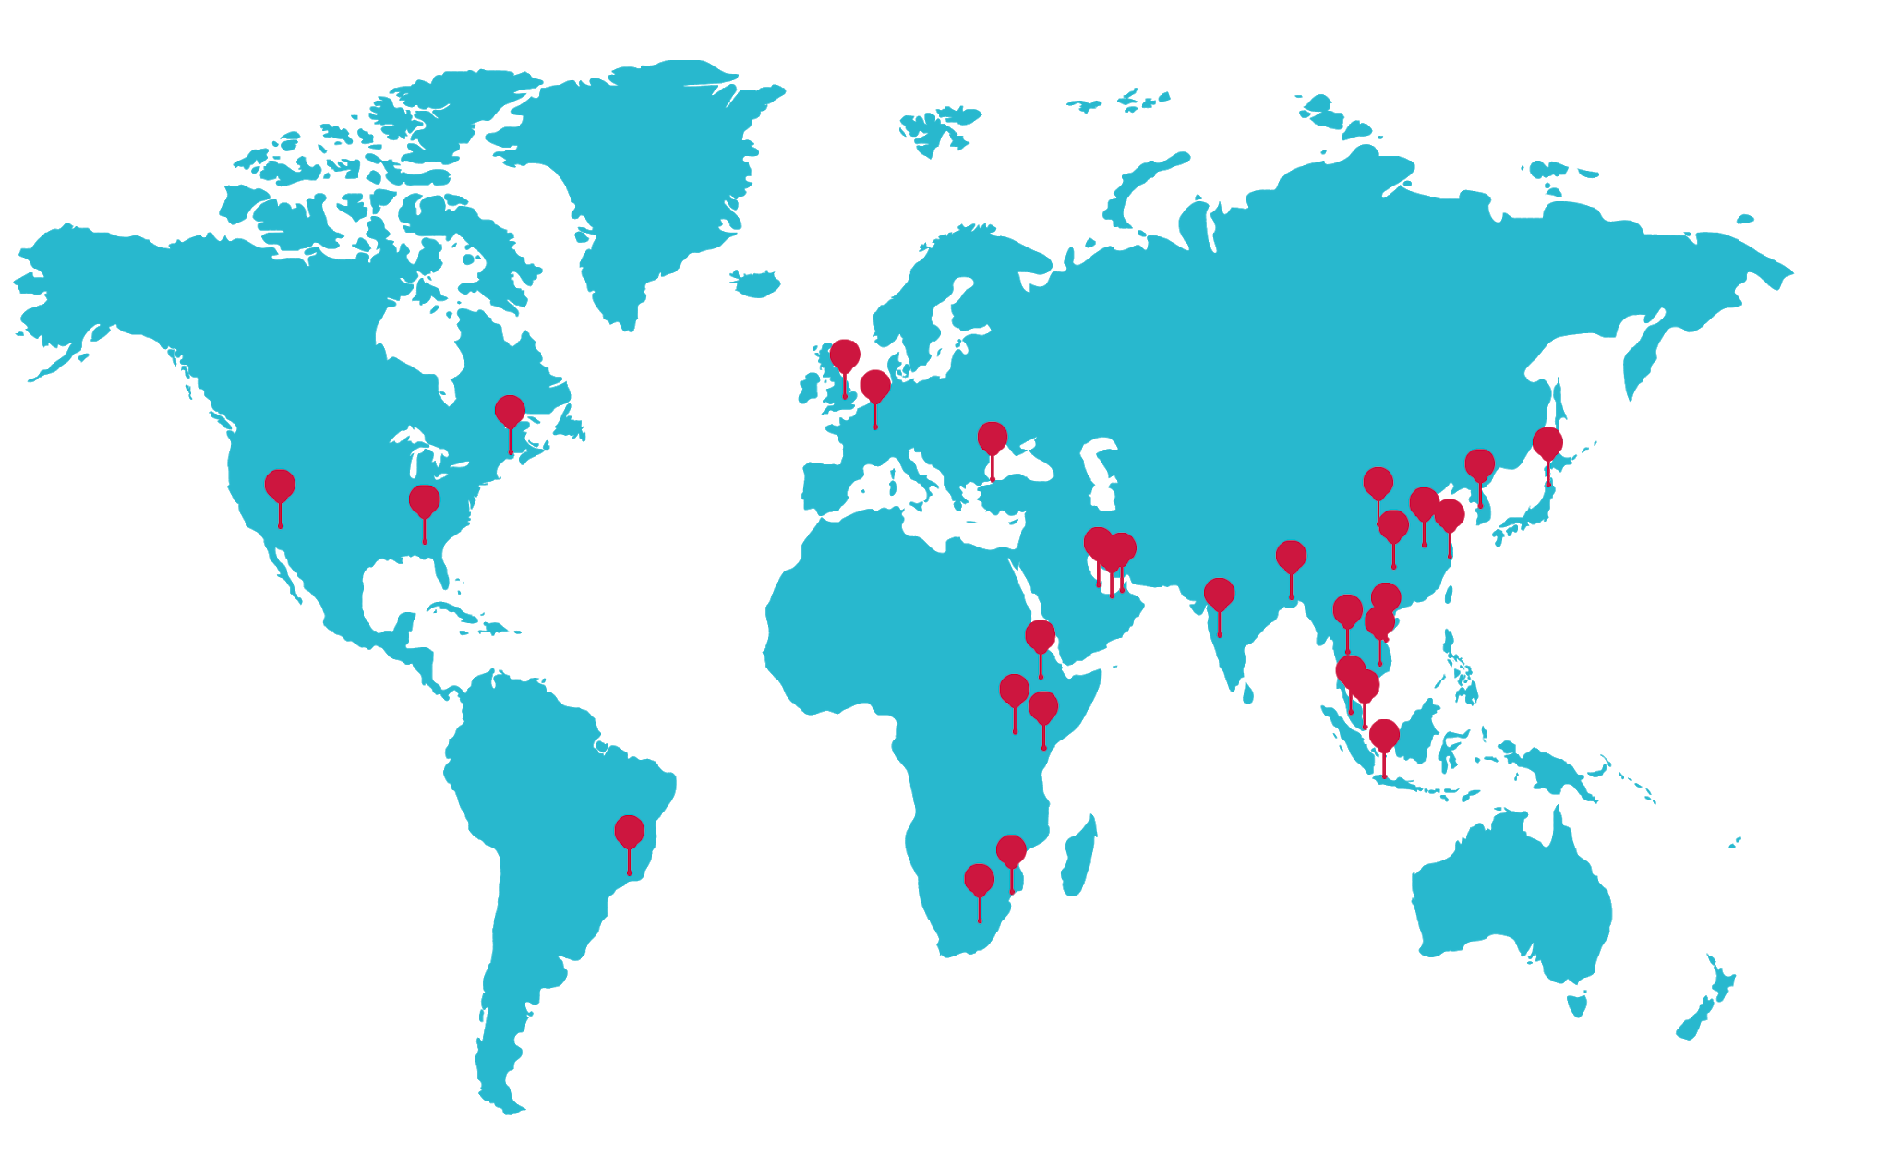
Wildlife Trafficking is Global
Global Air Trafficking Hotspots
Notes:
This is a global problem – illegal wildlife trade is taking place on every urbanized continent of the world.
But some airports are more exploited than others.
Some of the global wildlife trafficking hotspots are:
North America: New York and Los Angeles
South America: Rio De Janeiro
Africa: South Africa, Mozambique, Ethiopia and Kenya
Middle East Dubai and Doha
Europe: Moscow, London, Paris and other cities
Asia: India, Pakistan, Japan, China (Beijing, Shanghai, Kunming, Guangzhou and Hong Kong).
Southeast Asia: Manila, Jakarta, Singapore, Kuala Lumpur, Bangkok, Hanoi, Ho Chi Minh City.

Slide 8
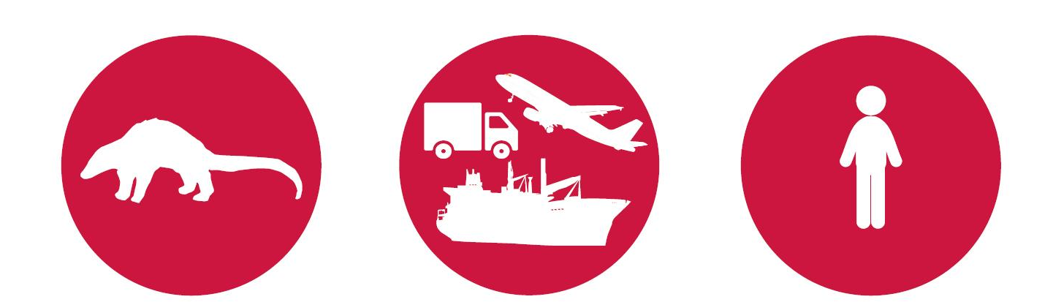
Source and consumption can be in different countries
Source Country
Transit Country
Consumption or Demand Country
Notes:
In some instances, wildlife is moved a considerable distance between its original source and the market where it will be sold and consumed.
Source – or ‘supply’ country. This is the location where a plant or animal was collected or produced.
Transit – wildlife is moved through this country or passes through its ports on its route from point of origin to end consumer.
Consumer – This is the end destination of the wildlife, where it is passed into the hands of its final buyer.
Some countries play more than one role, depending on the type of wildlife which is being traded.
National trade is when wildlife is collected or produced for sale and consumption within a country’s borders
For other wildlife, the main demand may come from outside the country where the animal or plant naturally occurs. This international trade might then involve a neighbouring country, one within the same region, or even one which lies far across the world in a different continent.

Slide 9
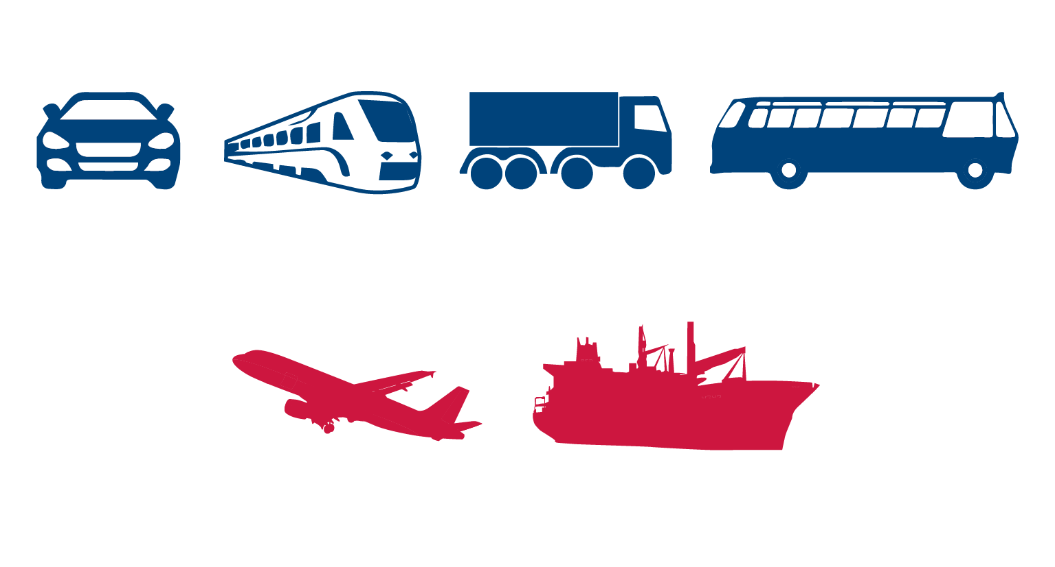
So transportation plays a major role
Overland
Air and Sea
Notes:
Because
Large volumes of illegal wildlife cargo start an overland journey hidden in cars, trucks, buses and trains to reach ports of exit
These are then loaded onto planes or ships to reach destination markets in other parts of the world

Slide 10
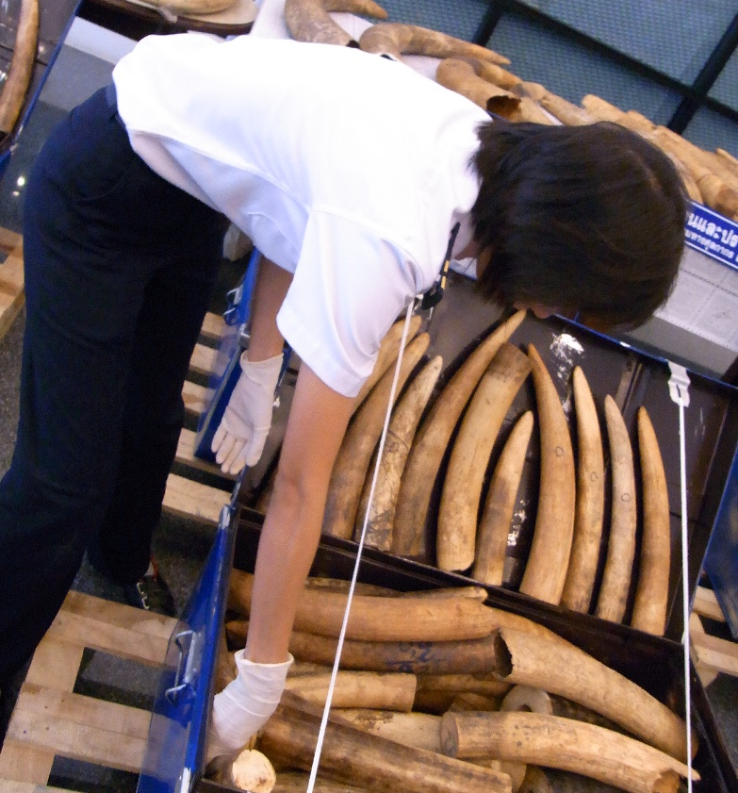
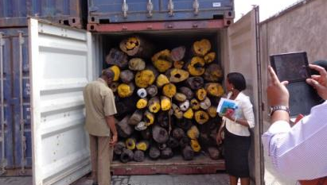
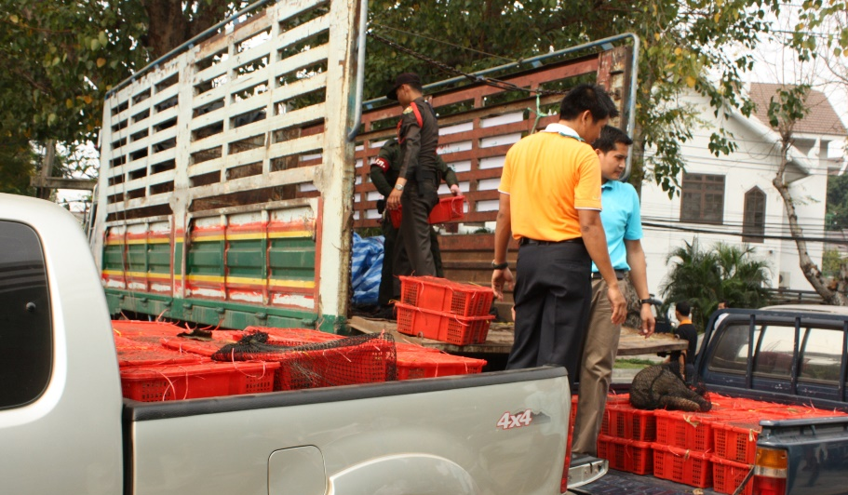
Transporting wildlife
SEA
AIR
LAND
© Freeland
© Freeland
Notes:
Smugglers use a variety of modes of transport to move smuggled wildlife.
This may include:
By land (motorbike, car, taxi, bus and trucks or train)
By sea in shipping containers,
By air.

Slide 11
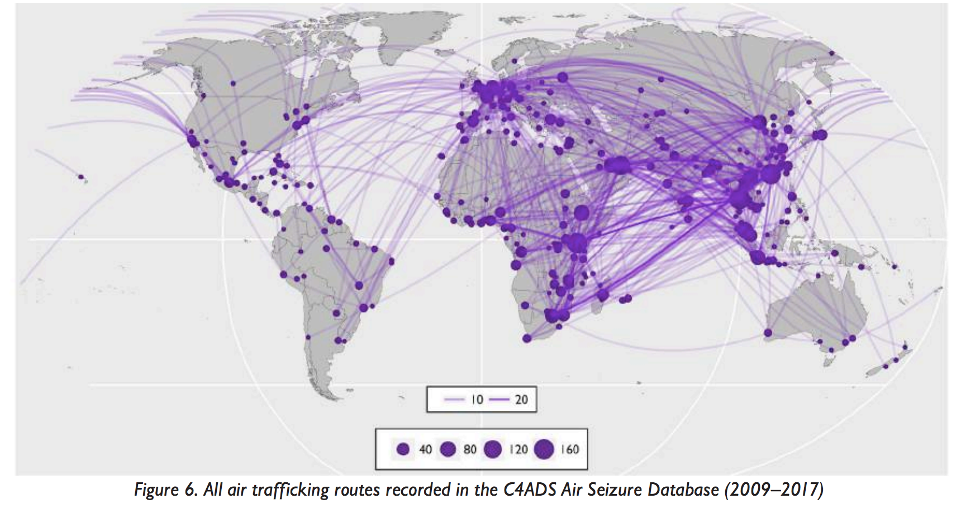
Major global air trafficking routes
Source: C4ADS, In Plane Sight. 2018
Notes:
This map of trafficking routes represents the flights used to traffic wildlife products through the air transport sector. This includes instances where the product did no actually enter a country because it was seized earlier in the route. The Transparency of the line for each route represents the number of times it was used. The bubbles represent the total number of flights to and from each city.
[Additional points that a speaker is welcome to use]:
Trafficked wildlife is moved across the globe.
This does not just involve Africa, Asia and South and Central America.
Trafficking routes also include Japan, Russia, the United States, Middle East and Europe as well.
We should always be aware of the possibility that wildlife traffickers are operating where we work.
Trends in wildlife trafficking change over time, as do the transport routes used by smugglers.
For example, illegal traders used to source pangolins from Southeast Asia,
Since wild populations have declined from poaching, many pangolins are now sourced from Africa to meet demand for these animals in Asia.
A large portion of smuggled wildlife originates in Africa and is destined for Asia.
Often trafficked wildlife will be moved from plane to plane at one or more locations.
Wildlife originating from Africa may be sent from, for example, South Africa and Mozambique to other airports (such as Addis Ababa in Ethiopia or Nairobi in Kenya) before leaving the continent.
Sometimes this is done because there are no direct flights, or to go via a location where known corrupted officials are stationed.
Transit locations may be used – even where there are direct flights.
Commonly used transit locations for wildlife originating in Africa include the Middle East, Europe and Asia.

Slide 12
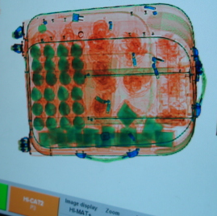
Why air transport?
Image goes here
Fast
Convenient
Cheap
Small chance of getting caught
Corruption
© ASEAN-WEN
Notes:
Why are airlines and airports used to traffic wildlife?
Air transport is fast:
Smugglers want to limit the amount of time that their contraband is in transit.
Cutting transport time means live animals have to go without food and water for a shorter period, reducing death rates and increasing profits.
Convenient:
Air transport gives opportunity for different travel routes to and from major origin and destination countries
Cheap:
Air travel has become fairly cheap, this means that the smuggling gangs spend less money to transport their goods.
The traffickers spend less on transport, leaving more money for profit.
Wildlife smuggling can be easy: you can pack the items in your baggage or carry it with you, no need for any documents or fees etc.
Relatively low risk:
With so many passengers flying, there is less chance of getting caught
Corruption:
In many places it isn’t that hard to find someone who is willing to help you by turning a blind eye for a fee (e.g, airline or airport staff, government officers etc.).
High profit margins make smuggling a lucrative business for criminals.

Slide 13
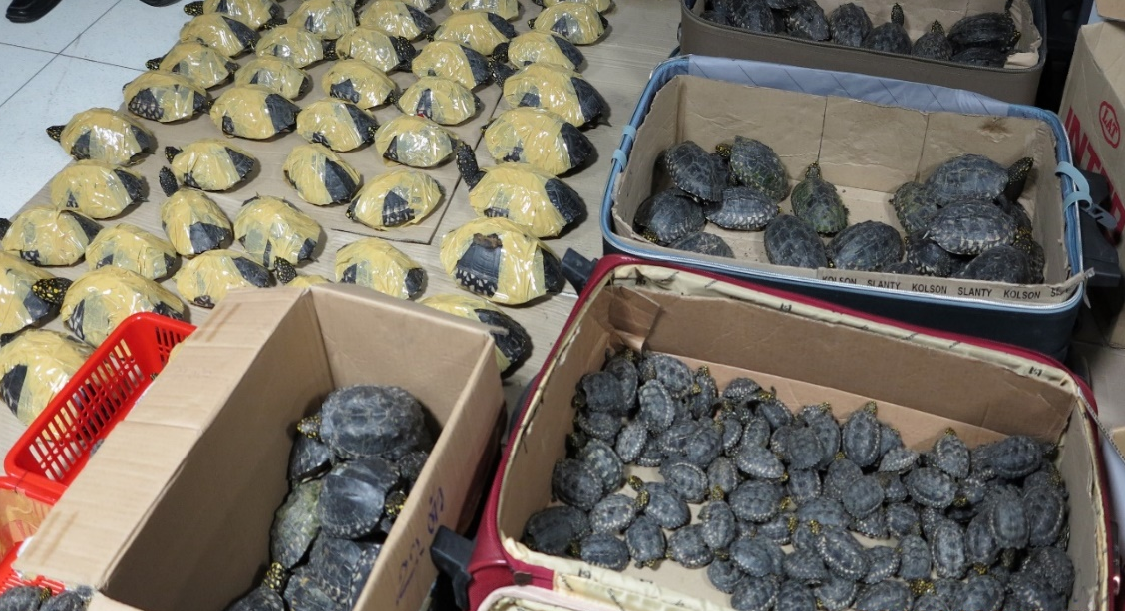
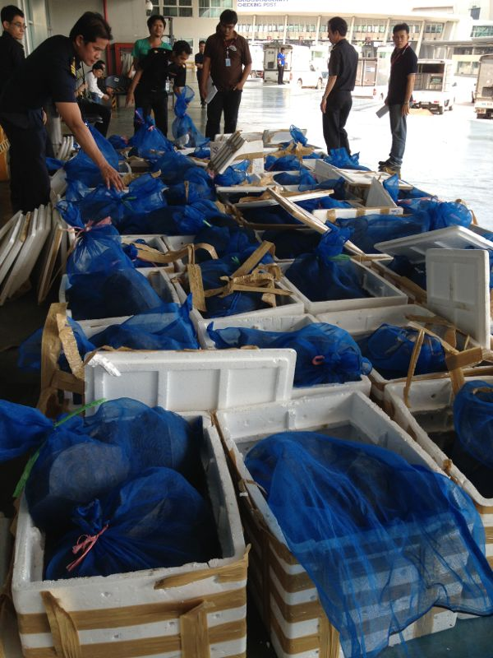
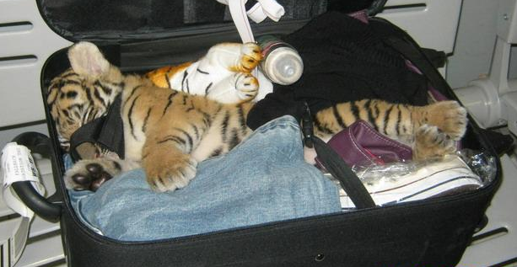
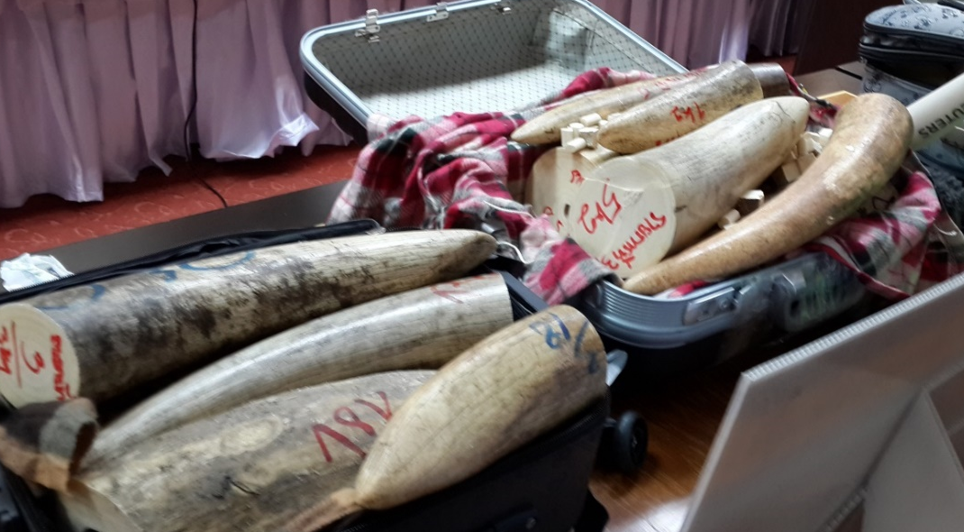
Wildlife trafficking using air transport
Image goes here
Image goes here
© Panjit Tansom/TRAFFIC
© TRAFFIC
© Wildlife Checkpoint Suvarnabhumi Airport
© Freeland/Matthew P
Notes:
A variety of methods are used to smuggle wildlife using air transport.
There is a wide spectrum of incidences including live animals, such as these spotted pond turtles (top left) or this sedated tiger cub (bottom left), to attempts to smuggle significant volumes of wildlife products, such as the these sacks of pangolin scales through air freight cargo (top) or these multiple suitcases full of rhino horn (below right).

Slide 14
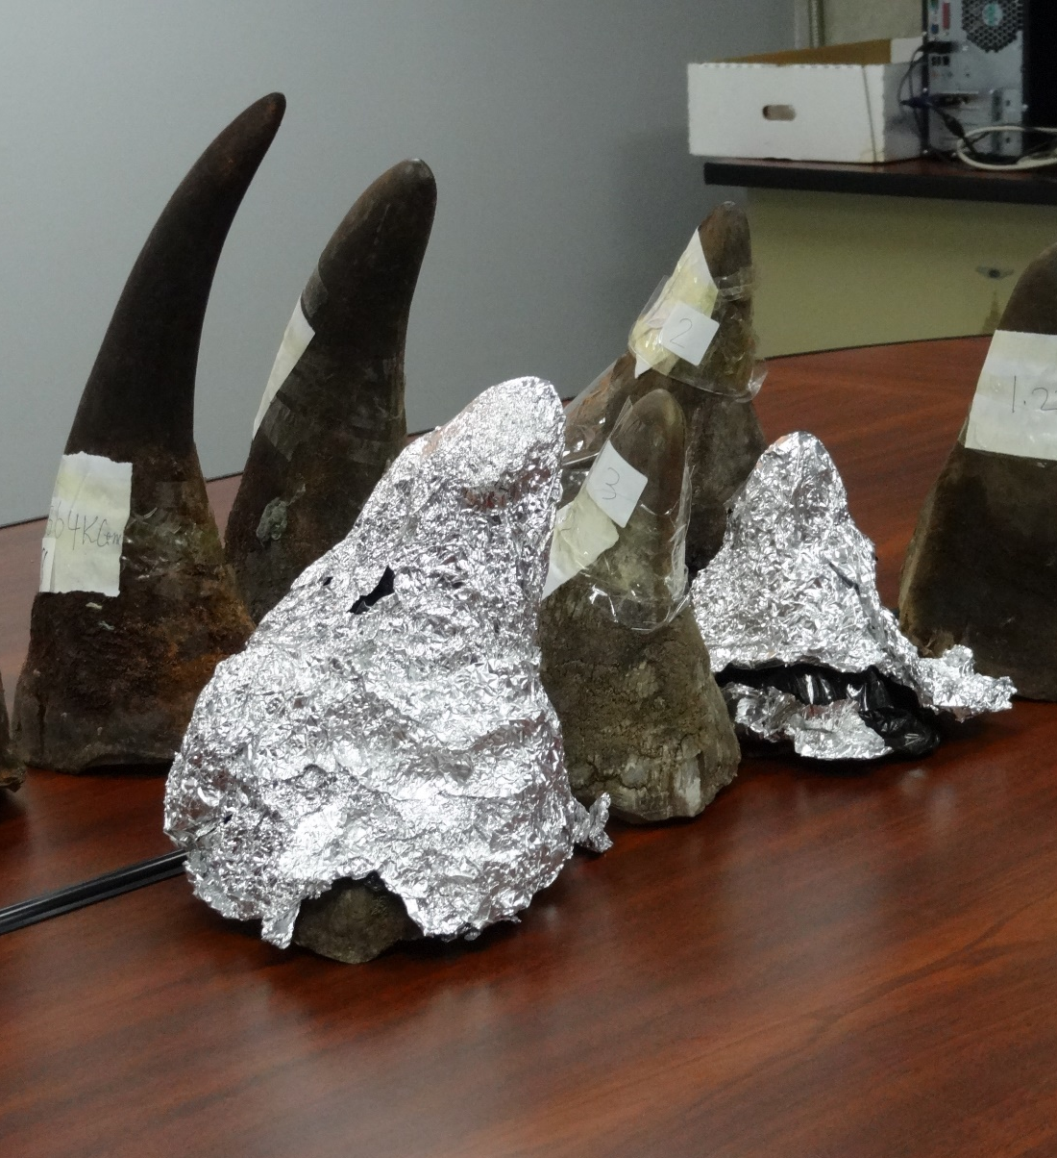
The movement of wildlife - Passengers
Image goes here
Passenger airlines
Small shipments
Live animals
High value
Hidden in carry-on or check-in baggage
Hidden on passengers
© Freeland
Notes:
Items which are smuggled by passengers tend to be:
Fairly small
Sometimes still living
Not too heavy – this seizure of rhino horn would be one of the heaviest smuggling attempts via a passenger
High in value
Hidden in carry-on or check-in baggage; or
Hidden on the passenger.
Examples include: Rhino horn, elephant ivory, curios, live reptiles, bird eggs, mammals.

Slide 15
The movement of wildlife - Cargo
Air cargo carriers and couriers
Larger shipments
Live animals and products
© TRAFFIC
Notes:
Items which are moved by air cargo and by couriers tend to be:
Larger in size
Heavier
Examples include: Pangolin products (meat and scales), elephant ivory, animal skins, tortoises, rare plants, tiger and lion bones.

Slide 16
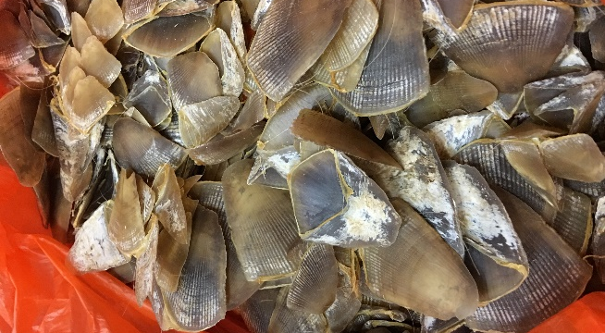
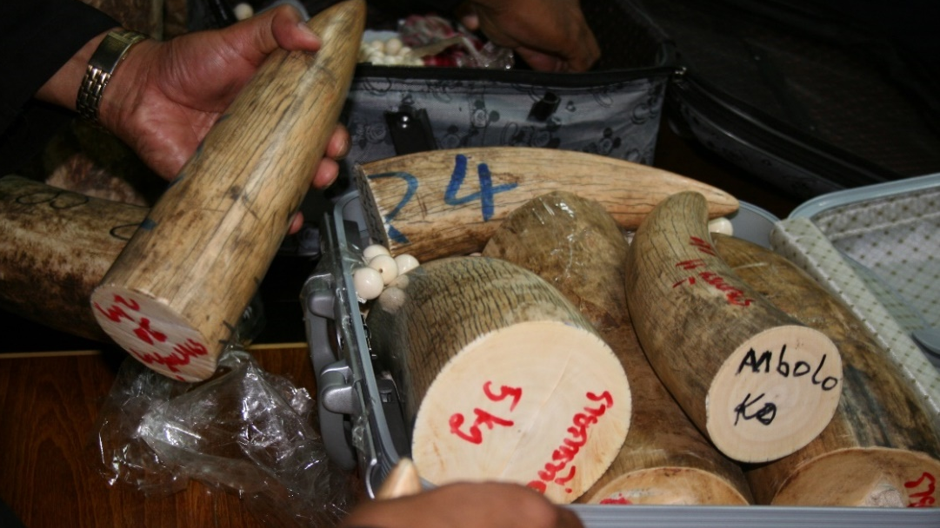
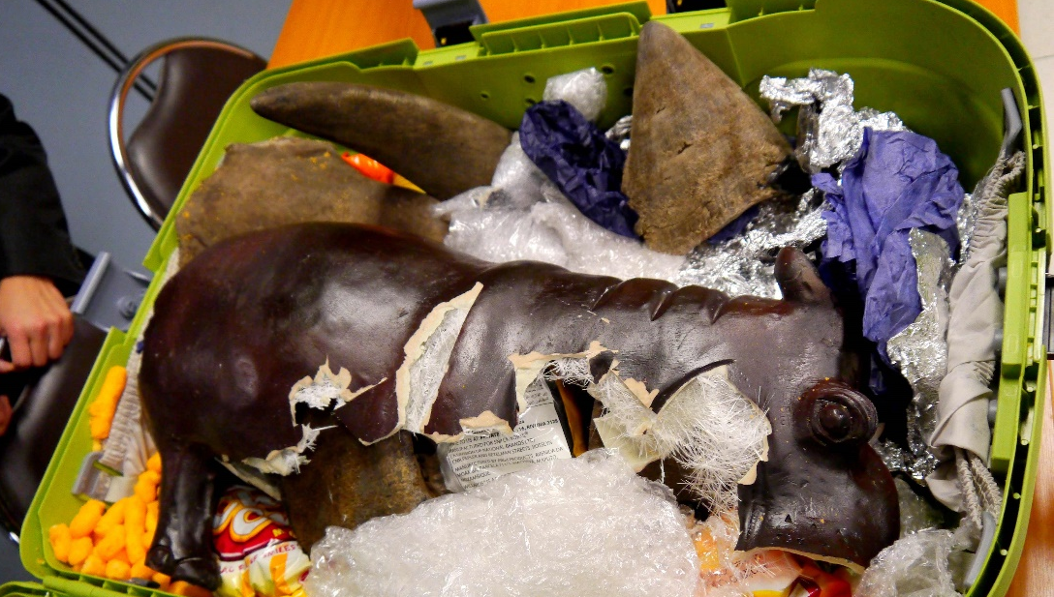
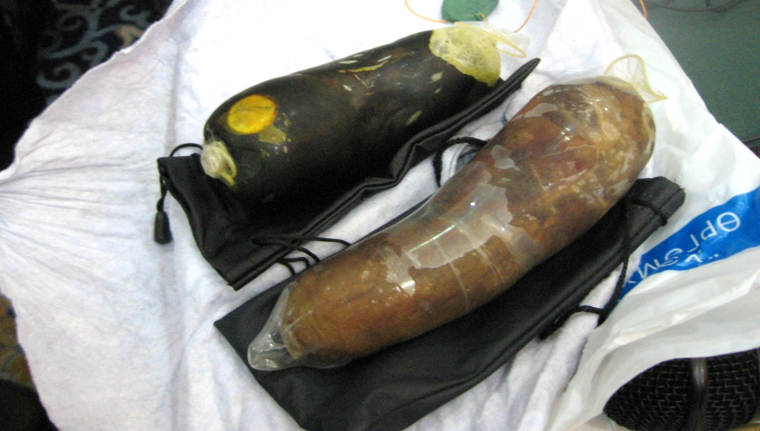
Wildlife smuggling by air – Products and Parts
© Kanitha Krishnasamy/TRAFFIC
© Freeland/Matthew P
© Freeland/Bussara T
© Joyce Wu/TRAFFIC
Notes:
Here are some examples of wildlife parts and products that have been trafficked by air:
(Ask your audience if they can identify these):
Top left: Pangolin scales:
Pangolins are thought to be the most trafficked mammals in the world.
They are found in Africa and Asia, but the demand for their scales (for traditional medicine) comes from East and Southeast Asia.
Pangolins are also traded for their meat.
Top right: Elephant ivory
Most commonly sourced in Africa and smuggled to Asia
Trafficking routes are varied and not always particularly direct.
Bottom left: Rhino horn:
These were hidden in a carving of a hippo in an effort to confuse customs at the airport
Bottom right: Bear bile:
Used as an ingredient in traditional medicine.
It is often extracted from living bears which may spend years confined in small cages.
The bear bile shown in this image has been frozen in a condom.

Slide 17
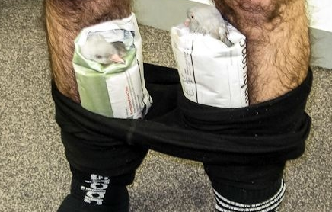
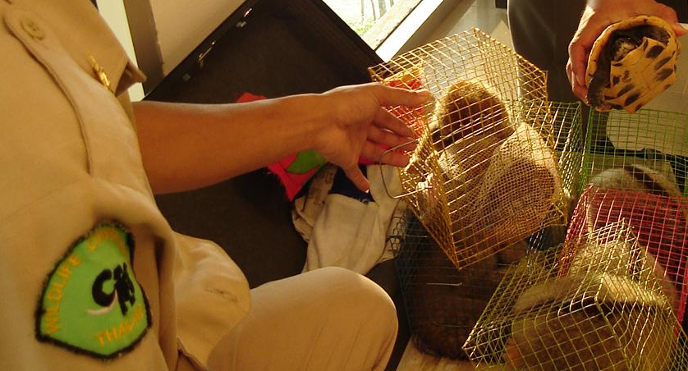
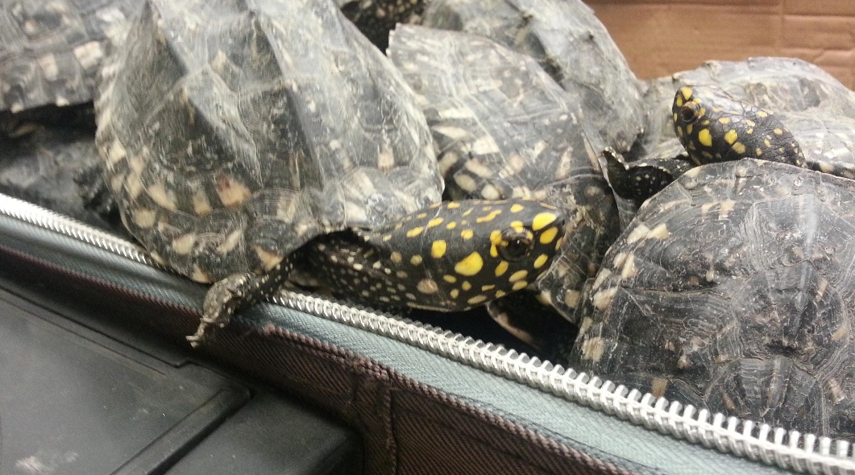
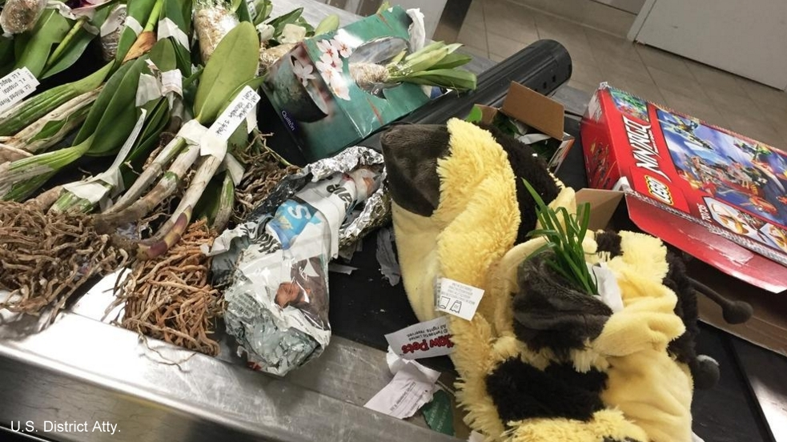
Wildlife smuggling by air – Live Wildlife
© Freeland / Bussara T
© Freeland / Matthew P
© Australian Customs Service
© U.S. District Atty.
© Australian Customs Service
Notes:
Live pigeons:
Two live pigeons were found hidden in the clothing of passenger from Dubai stopped at Melbourne international airport.
Live Orchids:
A man flying from Australia to Peru was found to have more than 200 live orchids hidden in his baggage.
The rare plants were hidden inside a plush toy, plastic tube and a number of boxes. http://www.latimes.com/local/lanow/la-me-ln-peruvian-national-pleads-guilty-orchids-20151030-story.html
Slow Loris confiscated in transit
Spotted Pond Turtles
Seized in Bangkok's international airport
The turtles were found after a baggage scan

Slide 18
Impact of
Wildlife
Trafficking on the Aviation Industry

Slide 19
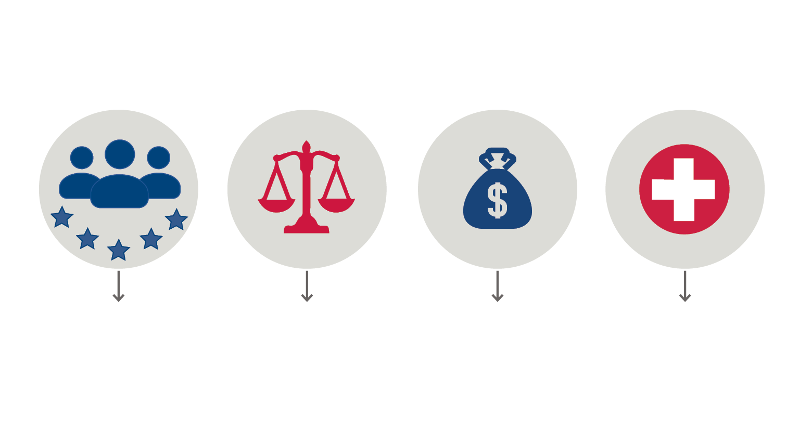
Wildlife Trafficking is a serious risk to aviation
Reputation
Legal
Economic
Safety
Media reports may give airline name, flight number or suggest staff involvement
Risk of prosecution for failing to ensure cargo is legal
Increased scrutiny leads to lost business
Risk of injury and spread of disease from smuggled wildlife
More checks
More delays
=
Notes:
Risks to the transport sector from wildlife trafficking include:
Reputational risk:
In some cases, media reports of wildlife seizures which are made at airports include the name of the airline (and/or flight number) on which the items were carried or were due to be carried.
In one example, press reports appeared claiming that a particular airline’s staff had been charged with the smuggling of turtles. The airline concerned issued a statement to deny that any of the accused worked for their company and stressed that they had a clear “zero tolerance policy for employers, contractors or service providers who are guilty of criminal offences and illegal activities”. Later press reports confirmed that the three men did not work for the airline, but the reputational damage had already been done.
The three men (who were not airline employees) were working in collaboration with the security scanner operator who escaped arrest. The turtles had been found inside the baggage of three passengers due to board for the flight. The passengers were taken aside and questioned, but it was not until security footage showed the men actually placing the animals in the bags that the true story emerged.
2. Legal risk:
There have been occasions where companies in the transport sector have been prosecuted for not making enough effort to ensure that shipments did not contain contraband after they were found to contain ivory. Many national laws allow for the seizure of vehicles used to transport illegal wildlife.
3. Economic risk:
Reputational and legal risks can lead to economic risk. Cargo customers and passengers are likely to avoid any transport provider whose services may be delayed through increased enforcement attention or have been linked to wildlife trafficking.
4. Safety risk:
There is a risk of injury to staff and passengers from smuggled wildlife. In 2015, passengers on two separate flights were stung by scorpions. It is not clear how the scorpions came to be on the flight.

